Slide 1

What affects The mortality of oysters?
Oyster Survey Corps
Ameer Mohamed, Danny Kim, Youssef Elmansoury, Mathew Wrizar, Mina Kim, and Tomou Takahashi

Slide 2
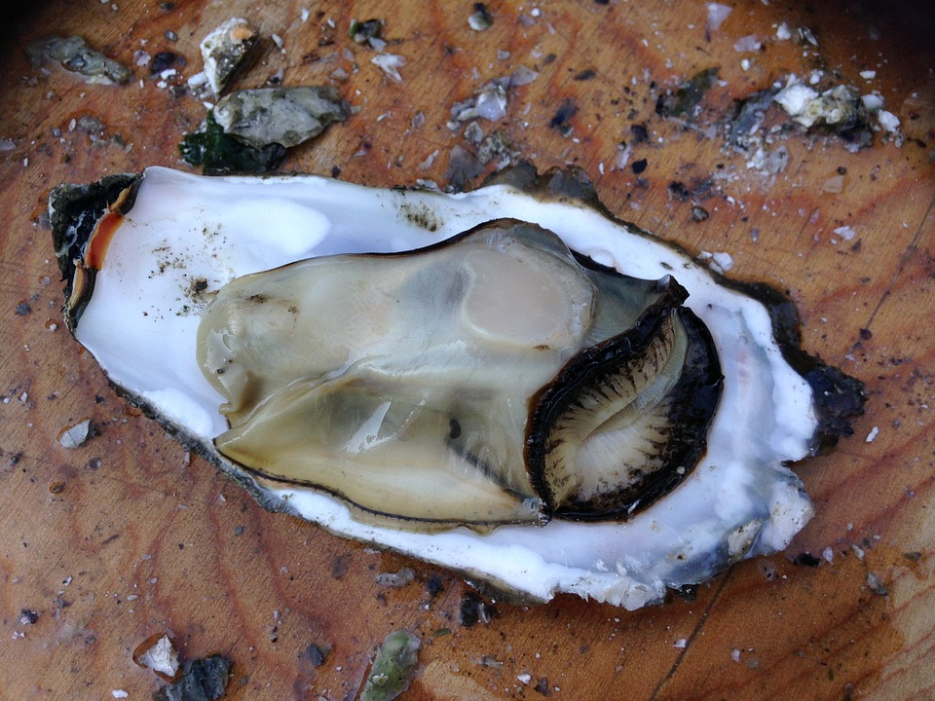
How we Got to This Research Question
We went through eight questions we produced by searching through the given data.
The scientists we talked to informed us that some questions were flawed.
We had only three options left and we choice this one: what things outside of PH, salinity, and temperature affect oysters.
The question was too narrow, so we made it broader, bringing us the final question: what affects the mortality rate of oysters.
Picture of an oyster

Slide 3
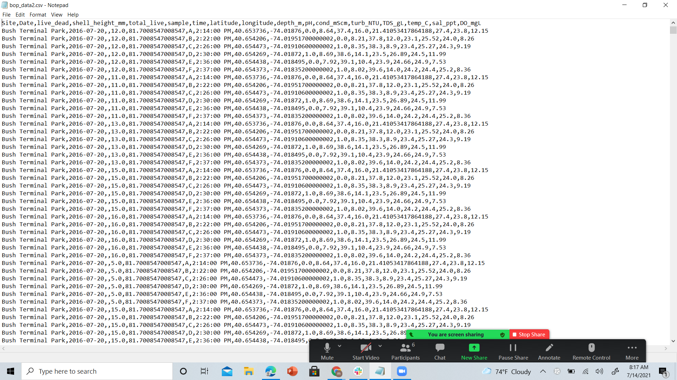
This is what the data looked like originally

Slide 4
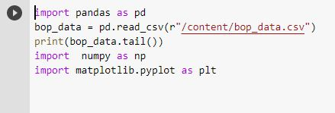
What we planned to do with the data
We looked for correlations in the data.
Connections that we thought would be prominent included: temperature to mortality rate, Turbidity to mortality rate, and the best height/size.
Ones that we thought wouldn’t have a big impact were salinity to mortality rate.
We planned to make a graph based on this.
We also wanted to see if the oysters were not only surviving but thriving.
When we upload all the data to Google Colab, we would be able to produce some graphs

Slide 5
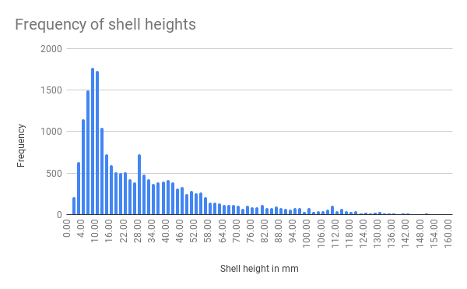
This is the graph of how frequent certain heights occur:
As you can see, around 10 mm is the most common height, meaning oysters with this height are most likely to survive

Slide 6
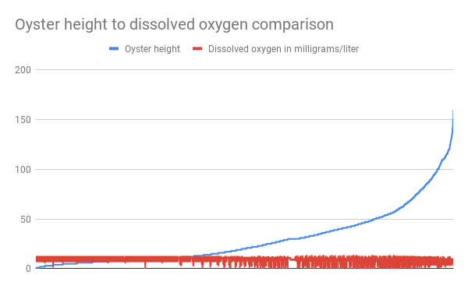
Height’s impact on oysters
Oysters' height impacts how much water they can filter, in turn impacting the amount of water they can cleanse. We thought that this would be the biggest impact because of this reason.
Here is a graph displaying what we mean:
As oyster Height goes up,
The amount of filtration increases.
So, as we thought, oyster height has a big impact
On oysters' mortality rate.
Note that some oysters are outliers because
they are dead.
Next is salinity

Slide 7
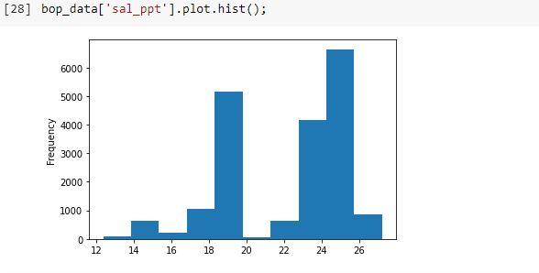
This is the graph of how frequent certain salinity occurs:
As you can see, 25 ppt is the most common salinity.

Slide 8


Salinity’s impact on oysters
When we started this project, we thought that salinity wouldn’t have a big impact on the mortality rate of oysters
We were right
According to the data, salinity doesn’t have a huge impact on oysters.
When looking at the oysters live and dead column, correlations with that and the salinity column do not exist.
This is just a sample: here
Is the live and dead column.
Oysters that are dead or alive
Don’t show that there is a huge
Difference in salinity.
The biggest difference in live salinity and dead salinity is around 1. The next thing considered is the turbidity (or water quality)

Slide 9
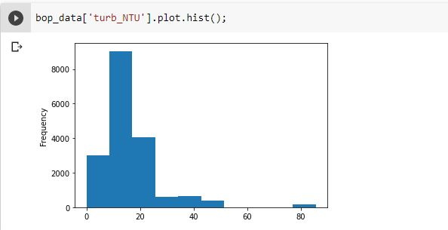
This is the graph of how frequent certain turbidity levels occur:
As you can see, 15 is the most common Turbidity level.

Slide 10

Turbidity’s impact on oysters
Turbidity should have a huge impact on oysters.
But, according to the data, it doesn’t.
When looking at the oysters live and dead column, correlations with that and the turbidity column doesn’t match .
The columns here show no correlation between
The live oysters and the dead oyster's turbidity.
Oysters that are dead or alive
shows that there is a
Difference in turbidity though.
The biggest difference in live and dead’s turbidity level is around 5. If the turbidity is higher, it is worse for oysters. The next thing considered is the temperature.

Slide 11
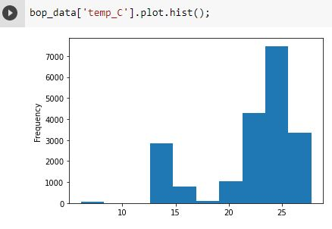
This is the graph of how frequent certain Temperature (in Celsius) levels occur:
As you can see, around 25 degrees Celsius is the most common tempurature level.

Slide 12

Temperature's impact on oysters
Temperature we thought should have an impact on oysters.
But, according to the data, it doesn’t.
When looking at the oysters live and dead column, correlations with that and the temperature column doesn’t match .
Here Is the live and dead column.
Oysters that are dead or alive
shows that there is a
Difference in temperature. But it does not
depend on the oysters being dead or alive
The biggest difference in live and dead and temperature level is around 2. If the temperature is higher, it is worse for oysters. The results weren’t what we thought they would be…

Slide 13
Results
The results were confusing to say the least.
We thought that salinity wouldn’t affect mortality rate, and we were right. But we also thought that turbidity had a huge role in mortality rate. But the data doesn’t make any correlations between them. Also, temperature was thought to be, to a smaller extent, a factor. Again, though, correlations were not found. Shell height, had a huge role to play. Filtering is why oysters have a major influence on water, and oysters that are taller filter more.

Slide 14
Our experience in the camp
It was a very informative camp, with it’s fair share hands on work. Coding was also very enjoyable. Becoming well versed in data science was also an amazing experience. Hopefully, we’ll do more projects like this in the future.

Slide 15
Conclusion
Many of the factors that we thought would affect oysters didn’t according to the data. The two we got right was that salinity wouldn’t have a big impact on oyster survivability and the oyster height would be a factor.

